Slide 1

Workflow Management systemS
Jacques Dainat Ph.D.

Slide 2

Workflow
A workflow is a defined sequence of tasks or activities that need to be completed in a specific order to achieve a desired outcome or goal.
https://doi.org/10.1038/s41592-021-01254-9

Slide 3
Workflow
Historically, developed using custom scripts or Make files
Makefile
# Specify the alignment file to be generated
alignment: trimming
command to align
# Specify the trimming required to make the alignment
trimming :
command to trim
Run make command in the directory where the Makefile resides

Slide 4
Why it a Workflow Management Systems (WMS)?
A Workflow Management System (WMS) is a software or platform that provides an infrastructure to setup, execute, and monitor workflows.

Slide 5


Why do we need workflow management Systems (WMS)?
As projects grow or age, it becomes increasingly difficult to keep track of all the parts and how they fit together.
Thx!!
Slide borrowed from

Slide 6

Why Workflow Management Systems (WMS)?
To automate series of bioinformatic processing steps.
To standardize analysis for large projects or core facilities (repetitive task)
Portability: simplify deployment of complex pipelines
Scalability
Optimise computation ressources (parallelization, times, …)
Improve reproducibility

Slide 7

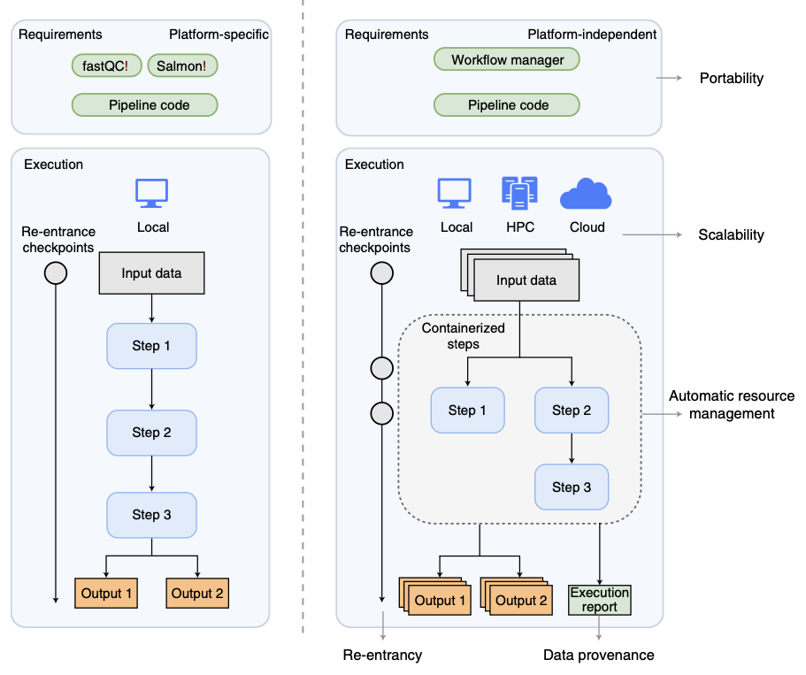
Traditional pipeline
Workflow manager
traditional pipeline implementations are coupled to the local compute environment and are sensitive to changes in software or data versions.
workflow manager decouples the code from the execution environment
containerized software makes local software installation requirements unnecessary. execution reports can track parameters and versions, providing transparency and data provenance.
https://doi.org/10.1038/s41592-021-01254-9

Slide 8
What Workflow Management System
There are over 150 workflow managers currently in use and under development
https://github.com/pditommaso/awesome-pipeline
https://github.com/common-workflow-language/common-workflow-language/wiki/Existing-Workflow-systems

Slide 9
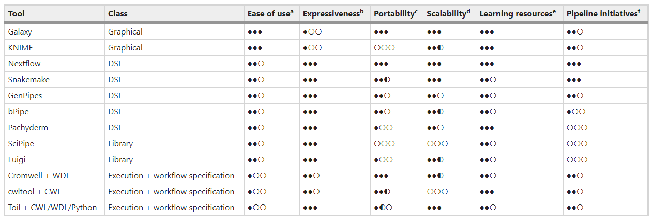
What Workflow Management System
Overview of workflow managers for bioinformatics
Galaxy a powerful choice for users with or without computational expertise who would like to assemble and run custom bioinformatics workflows.
https://www.nature.com/articles/s41592-021-01254-9

